Slide 1
Physical Origins of Errors in Transmon Qubits

Slide 2
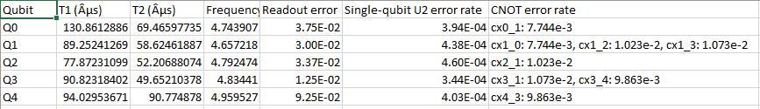

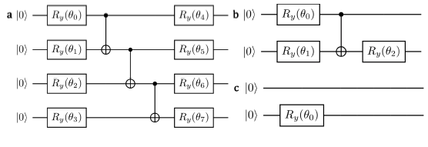
Initial Motivations
NPL quantum benchmarking project for quantum devices.
Disparity between error in Ivan’s circuit & IBM-reported fidelity values.
Probably not Non-Markovian error…
What does ‘gate infidelity’ actually mean/ how is it measured?
Is Randomized Benchmarking the
right approach?

Slide 3


A Priori Reasons against RB
Average gate fidelity – already assumes variance of error in gates is negligible.
RB is only an estimator of the above quantities! No mathematical proof of convergence of estimator to average gate fidelity.
‘What Randomized Benchmarking Actually Measures’ (Proctor et al 2017) goes further – demonstrates RB may even differ from the average over Cliffords by orders of magnitude.
Horodecki et al.

Slide 4
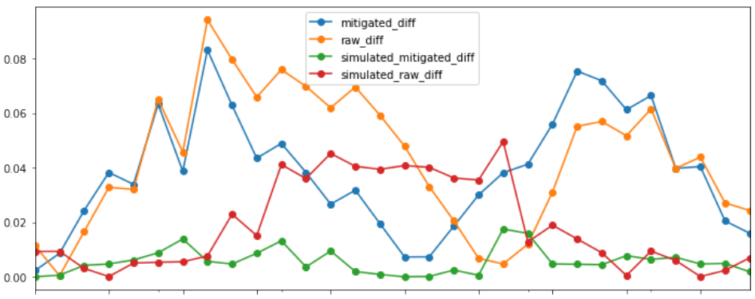
Parameterized Gateset Error is Not Uniform…
Error for a parameterized gate is not uniform across its parameters!
Hongxiang measured error vs rotation angle for RY rotations – big differences.
Aim to explain the physical origins of these discrepancies.

Slide 5
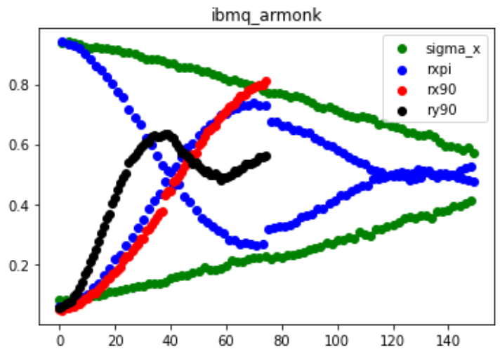
…Even the Same Gates Give Different Errors
I found discrepancies in X-gates implemented in different ways.
Evidence to show that ‘Clifford Gates’ are over-fitted to their theoretical results to improve RB figures…

Slide 6
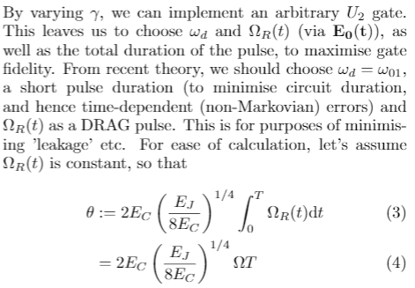
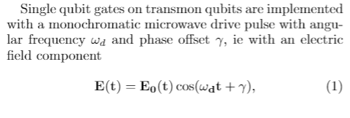
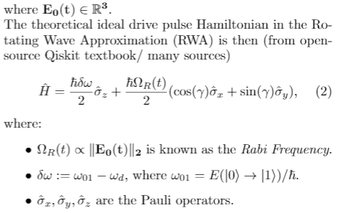
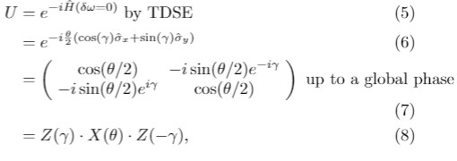
Background Theory

Slide 7
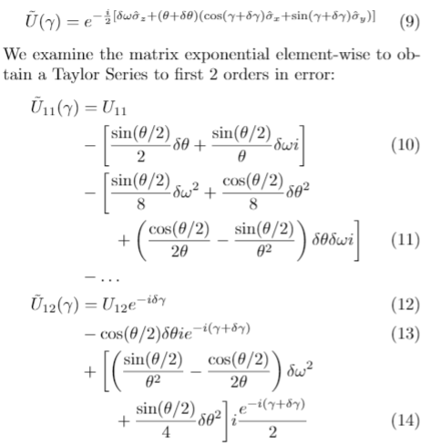

Developed Theory

Slide 8
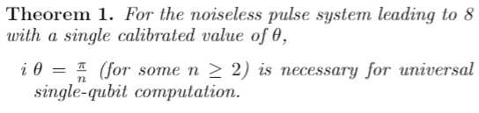

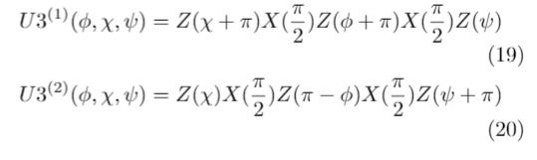
Theory – Picking Theta

Slide 9
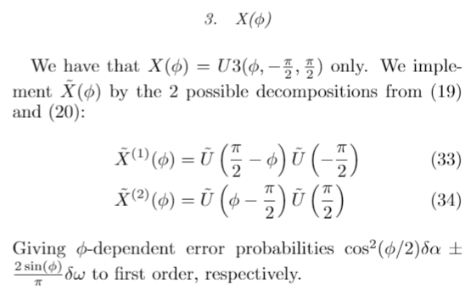
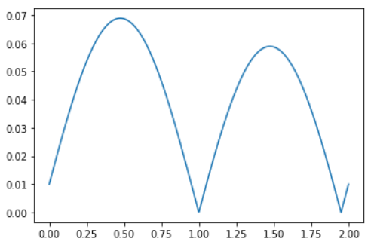
Explaining Errors
Still a work in progress
Explaining error in X(phi) vs phi below
(dtheta = 0.01, ORR = 0.1)
Examining errors may also allow for resolving
ambiguities in gate implementation

Slide 10
Theory Sum-Up
Starting with a general Hamiltonian, we can derive Taylor expansions for the matrix elements of a noisy PU(2) gate.
We demonstrate how these are built up by successive pulses and derive their optimal criteria.
Using some mathematical tricks we can get functions to explain our motivating examples!

Slide 11
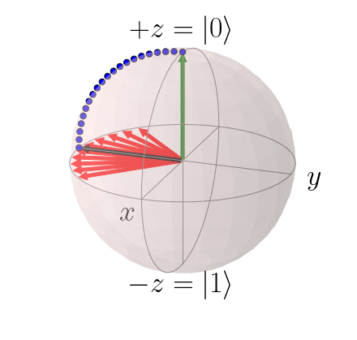
Experiment - Measuring Off-Resonance Error
Qiskit Pulse (formerly OpenPulse) affords fine tuned control over quantum devices.
ORRs measured using Ramsey Inferometry.
This is also how the machine is calibrated – in theory ORRs are zero straight after calibration.
‘Drift’ during the day.

Slide 12
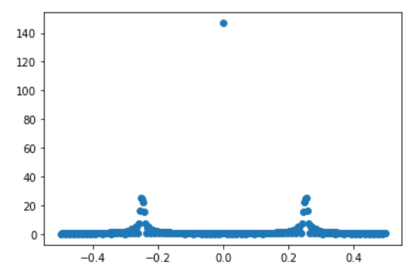
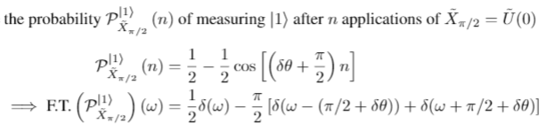
Experiment - Measuring Angle Error
Using Qiskit Pulse, we can measure qubit drive frequency and set this as the drive pulse.
Otherwise (sufficiently small) ORRs can be corrected using virtual Z-gates in OpenQASM anyway.
Since ORRs = 0, we have the following elegant expression.

Slide 13
Conclusions
RB is useful to compare qubits across devices – but it is useless for predicting errors on specific circuits.
We provide a theoretical model to predict single qubit gate error. Further experiments are needed to verify it.
We also provide a new way to measure angle error. This is important as angle error is difficult to calibrate exactly.
Initial research suggests a similar path could be used to find gate errors for 2 qubit (‘cross resonance’) gates, giving a universal model.

